Slide 1
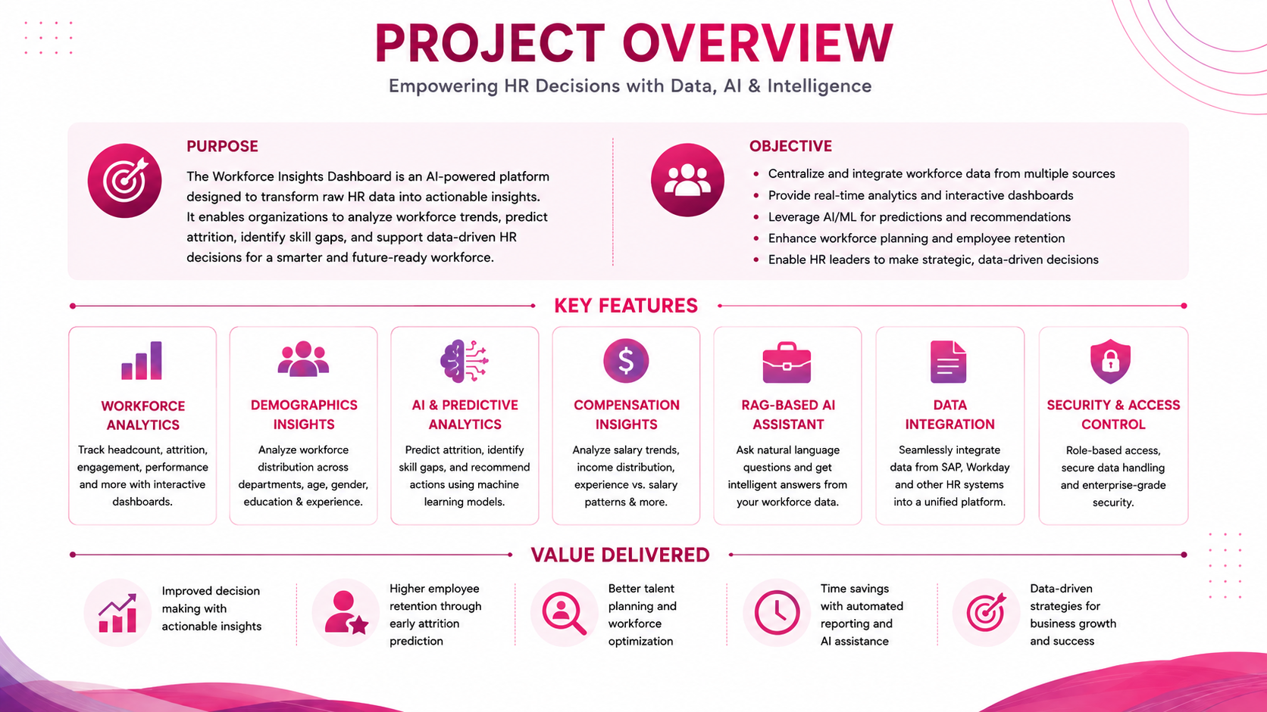










Internship Project Presentation
Project Title
Workforce Insights Dashboard for Employee Skill and Analytics
Transforming workforce data into Actionable HR intelligence using data analytics , RAG, and AI
Technology Stack:
Python
Pandas
Seaborn
Power BI
Streamlit
Python Flask
Postgres DB
Grok API
Presented by: Team 2 Under the guidance of: Mrs. Neha Mam

Slide 2

Problem Statement
Traditional HR analysis often faces these challenges:
Proposed Solution
Workforce data is distributed across different sources.
Raw HR data requires significant preprocessing before analysis.
Important workforce trends can be difficult to identify manually.
HR managers need interactive and easy-to-understand visual analytics.
A unified Al-powered workforce analytics platform that combines data analytics, Power BI dashboards and a RAG-based Al assistant.
Querying workforce information often requires technical knowledge.
Static reports do not provide contextual, conversational insights.
3/17
Team 2

Slide 3

Project Overview
Our project aims to transform raw HR workforce data into actionable intelligence through:
1. Data Analytics
2. Business Intelligence
2. AI Workforce Assistant
2. Centralized Platform
Workforce analysis
Employee demographics
Salary and experience analysis
Attrition analysis
Satisfaction and work life balance analysis
Interactive Power BI dashboards
Executive-level KPIs
Department and role analysis
Workforce trend visualization
RAG-based question answering
Al-generated workforce insights
Document-based knowledge retrieval
Admin decision-support capabilities
Dashboard access
Dataset visualization
Al assistant
Document management
Admin management
This creates a complete pipeline from Data to Insight Decision Support, empowering HR teams to make smarter, faster, and data-driven workforce decisions.
2/17
Team 2

Slide 4
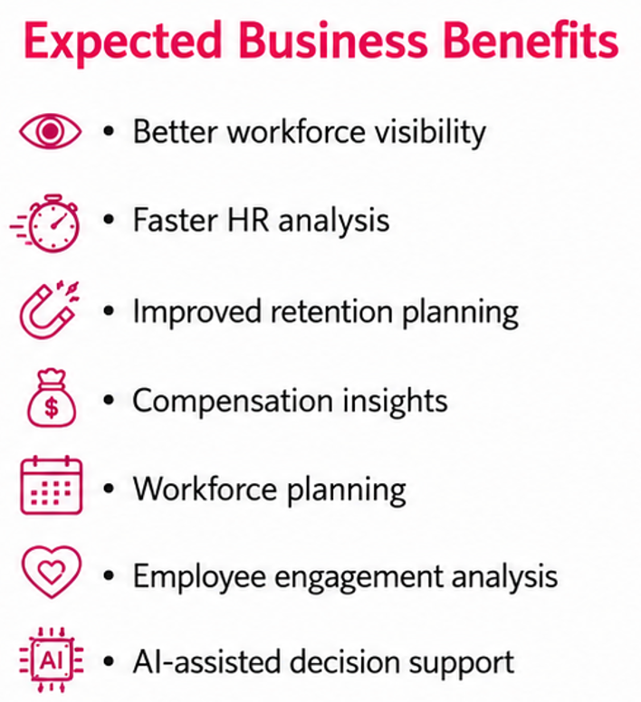

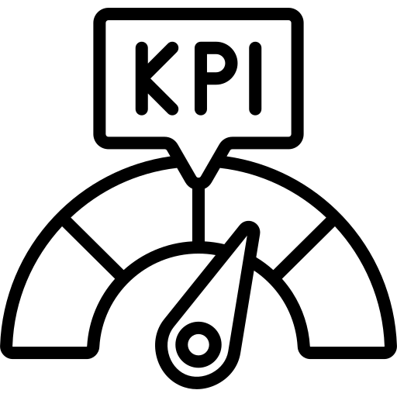

Project Objectives
Primary Objectives:
Expected Business Benefits:
Prepare and validate workforce data.
Better workforce visibility
Faster HR analysis
Improved retention planning
Compensation insights
Workforce planning
Employee engagement analysis
Al-assisted decision support
Perform comprehensive exploratory data analysis.
Identify factors associated with employee attrition.
Build an interactive workforce intelligence dashboard.
Provide executive-level workforce KPIs.
Develop a RAG-based Al Workforce Assistant.
Provide secure administrative management.
Support data-driven HR decision-making.
Our mission is to turn workforce data into meaningful insights and empower HR teams to make smarter, faster, and strategic decisions.
4/17
Team 2

Slide 5
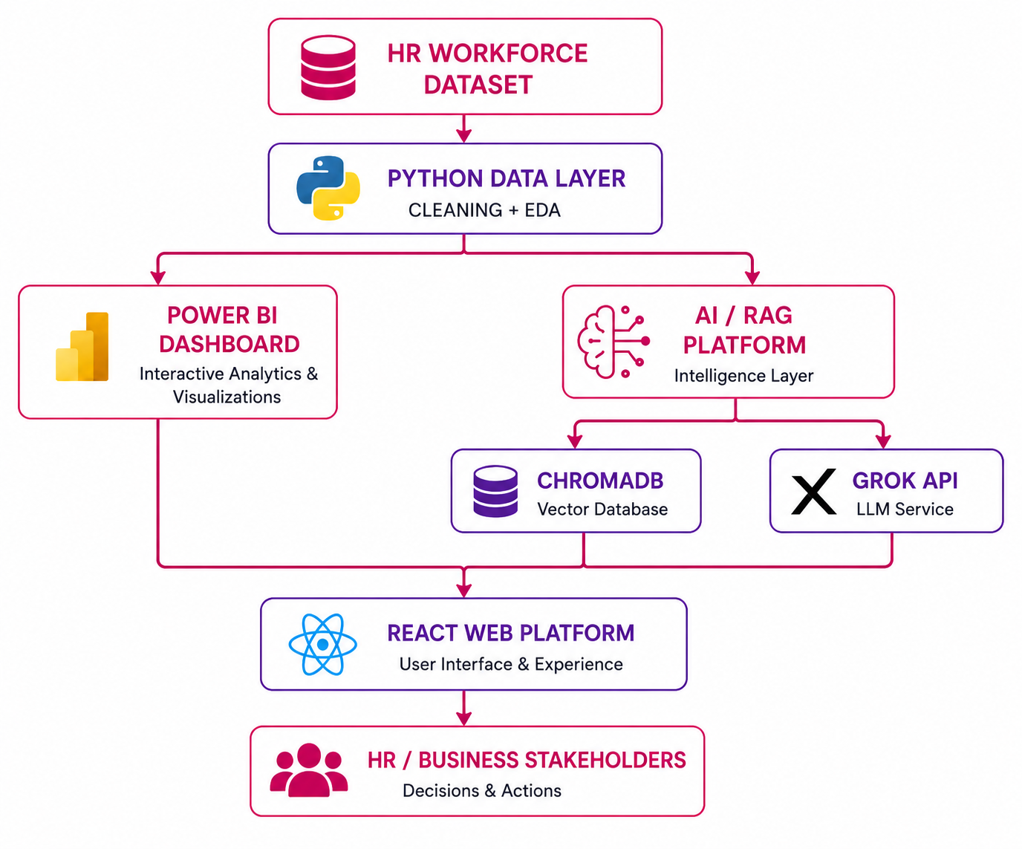
Complete Platform Architecture
Building an Intelligent Workforce Insights Platform
13/17
Team 2

Slide 6
Data Cleaning & Preprocessing
Clean Data → Reliable Analysis → Better Workforce Insights
01
02
03
Data Inspection
Data Standardization
Data Transformation
Checked data structure, types, and distributions.
Identified missing values, duplicates, and outliers.
Standardized formats, labels, and categorical values.
Unified naming conventions and data formats.
Encoded categorical and normalized numerical data.
Prepared features for analysis and modeling.
04
05
Data Validation
Clean Data Output
Validated data accuracy, consistency, and integrity.
Confirmed the dataset was analysis-ready.
Cross-checked with source systems and applied validation rules.
Generated clean, structured, reliable data.
Prepared data for Power BI and AI/RAG analysis.
Optimized for performance, faster retrieval, and accurate insights.
6/17
Team 2

Slide 7

ML Model
Feature Selection
Select relevant employee attributes for predicting attrition.
6.
1.
Logistic Regression
Apply Logistic Regression as the classification algorithm.
Data Preprocessing
Clean and prepare the dataset for model training.
5.
2.
Binary Classification Predict two outcomes: Attrition = Yes / No.
HR Dataset
Employee workforce data with demographic, job, satisfaction, income and experience features
Attrition Prediction
Generate the predicted employee attrition probability.
4.
3.
8/17
Team 2

Slide 8

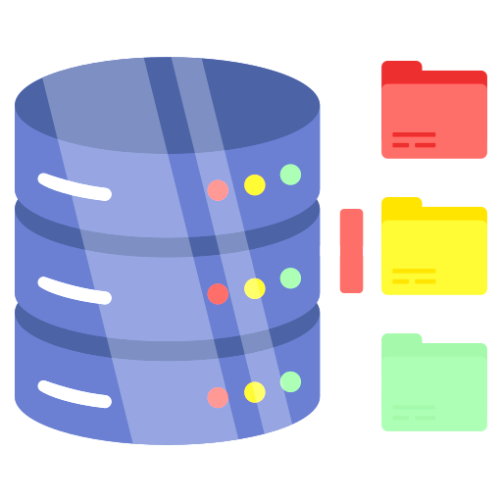

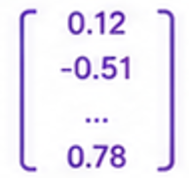


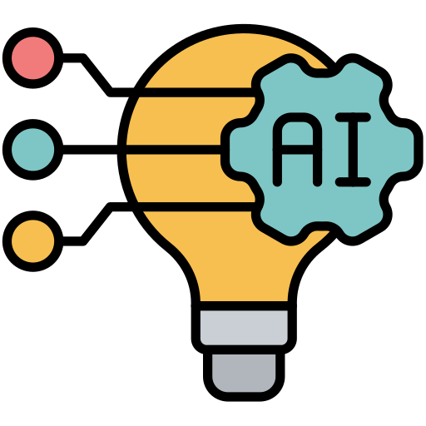

RAG-Based AI Workforce Assistant
Retrieval-Augmented Generation for Intelligent Workforce Insights
1
3
5
USER QUESTION
2
BACKEND API
4
SEARCH POSTGRES DB
PYTHON FRONTEND
(Python FastAPI)
GENERATE EMBEDDING
Search the vector database for semantically relevant information.
User ask a workforce related question.
Backend receives the request, validates and processes it.
Frontend Captures the question and sends to backend.
Convert the question into a vector embedding.
10
8
6
STREAMLIT UI
GROK API (LLM)
TOP 5 CHUNKS
9
7
GENERATE ANSWER
CREATE PROMPT
Answer is sent back and displayed to the user.
Prompt is sent to Grok API to generate intelligent answer.
Retrieve top most relevant text chunks.
LLM generates accurate, context –aware answer based on retrieved data.
Combine the user question with retrieved context to create a rich prompt.
12/17
Team 2

Slide 9
Business Impact & Recommendations
3. Review Compensation
Analyse income-related attrition patterns
Consider experience and job level
6. Continuous EDA & Monitoring
Regularly analyse workforce data
Update dashboards and HR insights
1. Monitor Overtime
Track overtime patterns
Review workload and work-life balance
STEP
02
STEP
04
STEP
01
2. Focus on Younger Employees
Monitor their attrition patterns
Support engagement and career development
STEP
03
4. Monitor Department & Role Attrition
Compare attrition percentages
Identify areas needing attention
STEP
05
14/17
Team 2

Slide 10
Challenges & Limitations
CHALLENGES
LIMITATIONS
DATA QUALITY & CONSISTENCY
HR data is scattered across multiple systems with inconsistent formats, missing values and duplicates.
DEPENDENCY ON DATA SOURCES
Insights and recommendations are only as good as the data quality and completeness from source systems.
DATA PRIVACY & SECURITY
Handling sensitive employee data requires strict access controls and compliance with data protection regulations.
RAG RETRIEVAL LIMITATIONS
Retrieval quality depends on the relevance and coverage of documents stored in the vector database.
AI ADOPTION & TRUST
Users may be hesitant to rely on Al insights; building trust in Al-generated responses takes time and education.
REAL-TIME DATA CONSTRAINTS
Some insights may not be real-time due to data refresh schedules and system update cycles.
PERFORMANCE & SCALABILITY
Ensuring fast response times and handling large volumes of data and concurrent users can impact performance.
SCOPE BOUNDARIES
The current scope focuses on HR analytics and assistant features and may not cover all future business needs.
CHANGE MANAGEMENT
Adoption depends on user training, awareness and aligning the platform with existing business processes.
EVOLVING BUSINESS NEEDS
Changing workforce trends and business priorities may require continuous updates and enhancements.
16/17
Team 2

Slide 11
Workforce Insights Dashboard for Employee Skill and Analytics
Transforming workforce data into Actionable HR intelligence using data analytics , RAG, and AI
Any Questions?
THANK YOU!
Technology Used:
Python
Pandas
Seaborn
Power BI
Streamlit
Python Flask
Postgres DB
Grok API
Team 2

